Slide 1

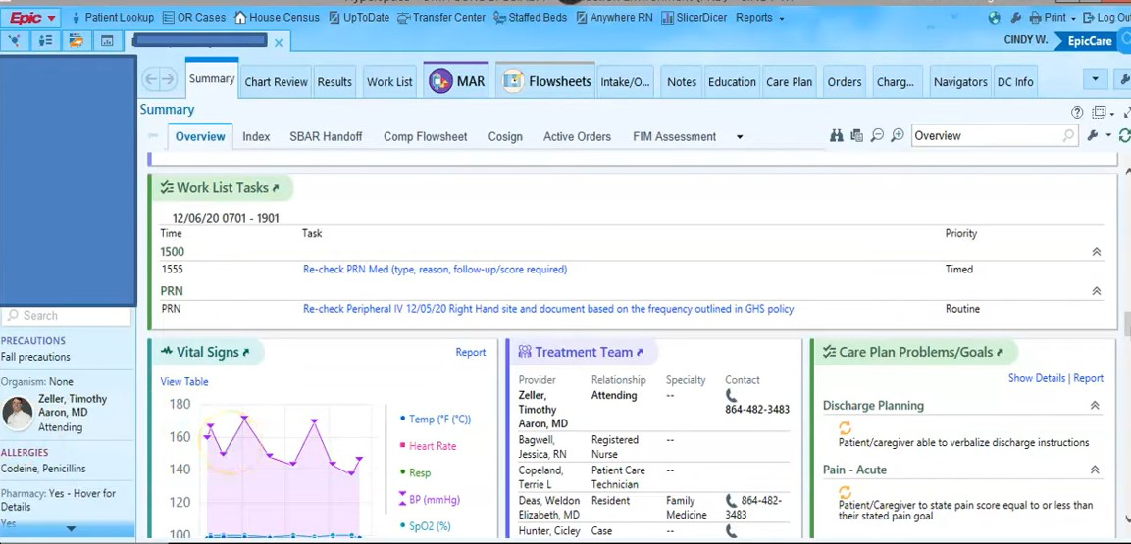


EHR Innovation- Symptom Tracker
Coders:
Kesjiah Wilcher, Nickya King, & Tiana Cliett
“From paper to screen, it’s better care than we’ve ever seen!”
Notes:
The goal of this innovation is to produce an electronic health record that is compatible with different softwares. This innovation will feature a symptom tracker that will evaluate the symptoms of patients while providing the users, physicians, specialists, hospitals, and patients with appointment availability, previous lab tests, and diagnoses to cut costs, unnecessary testing and to accurately diagnose patients.

